Slide 1
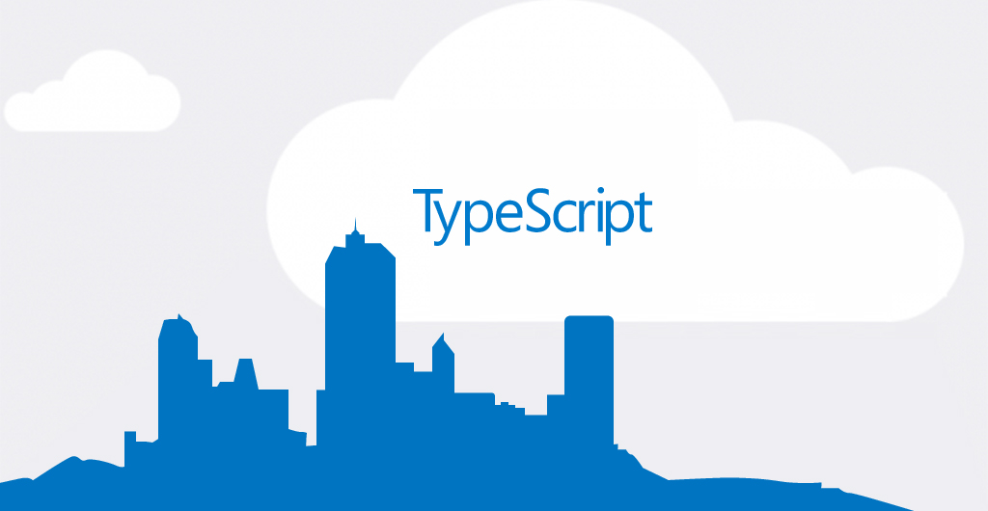

Slide 2
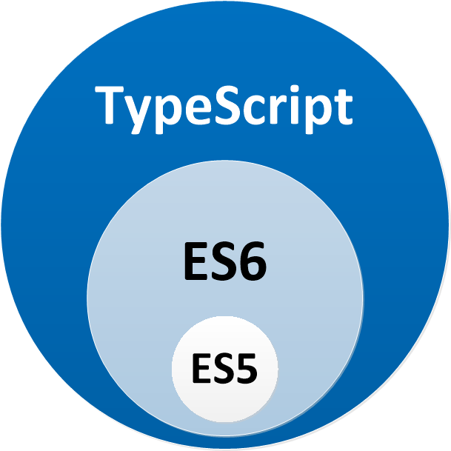
What
Typescript is a typed superset of Javascript that compiles to plain Javascript

Slide 3


What
Open source
Created and maintained by Microsoft
Notes:
Creator:
Anders Hejlsberg

Slide 4
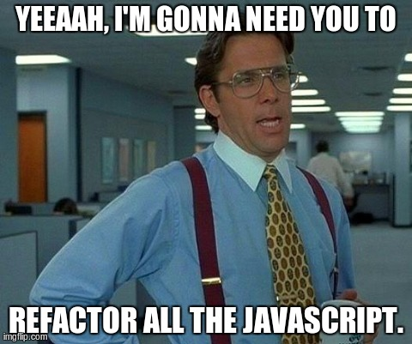
Why
Optional type system.
Future Javascript now
You already know Typescript
Maintainability
Notes:
Mantenibility
Greatly improves refactoring (Ex: upgrade libraries)
The documentation is your code
Improves life for the developers using your code
Encourages you to structure better your code
When you have hundreds of files you will suffer

Slide 5
Transpile
TypeScript
ES5 Javascript
class Greeter {
greeting: string;
constructor (message: string) {
this.greeting = message;
}
greet() {
return "Hello, " + this.greeting;
}
}
var Greeter = (function () {
function Greeter(message) {
this.greeting = message;
}
Greeter.prototype.greet = function () {
return "Hello, " + this.greeting;
};
return Greeter;
})();

Slide 6
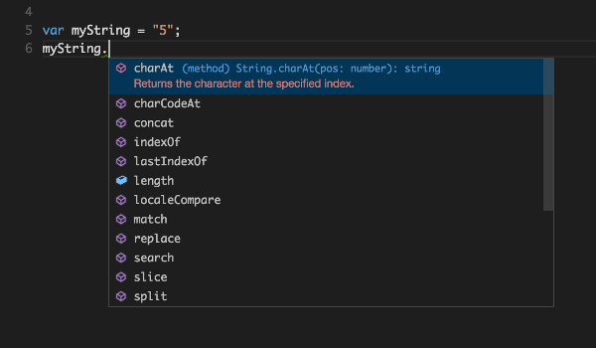
Advantages
Is Javascript (.JS -> .TS)
Transpile target (ES3..5..6) (like Babel)
Type inferring
Early adoption of ECMA standards
Spot errors as you type the code
… and
Intellisense!!!
Notes:
All your favourite languages typed! (Jquery, Angular, React, D3, RxJS…)
Transpile to readeable JS
Intellisense:
Enhances so much your IDE (Javascript for tools)

Slide 7
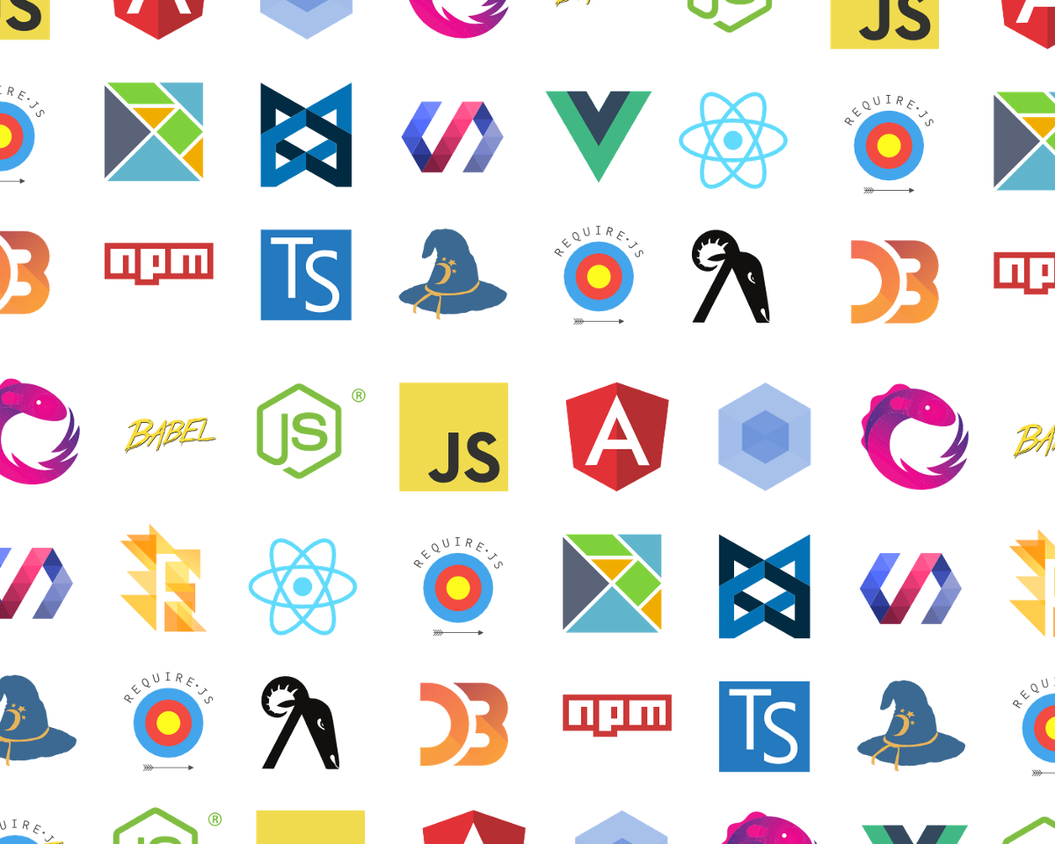
JS libraries typed
DefinitelyTyped community

Slide 8
LET’S CODE

